Slide 1
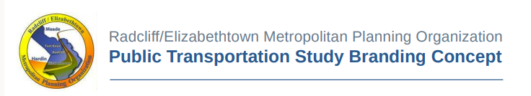
Meeting the
Public Transportation Needs in the REMPO Area

Slide 2
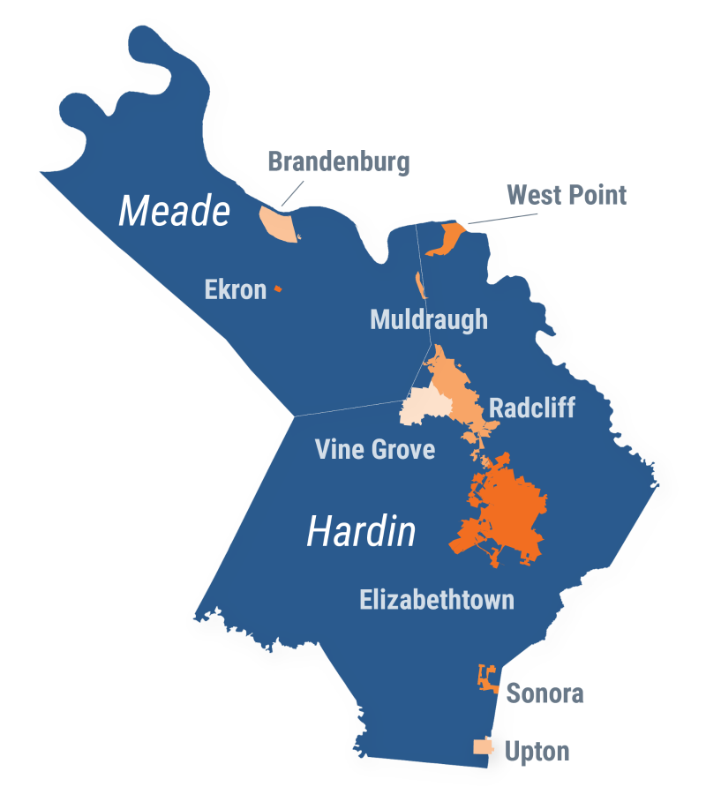
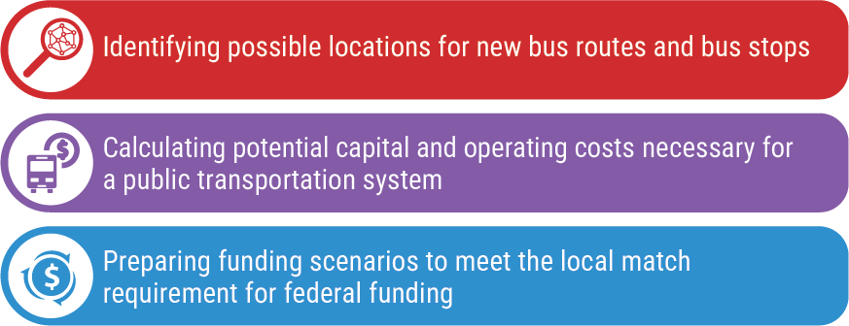
Purpose of Study
The Radcliff/Elizabethtown Metropolitan Planning Organization (REMPO) works to meet the transportation needs of Hardin and Meade Counties. The purpose of this study is to analyze the need for and feasibility of implementing a fixed-route public transportation system within the Radcliff/Elizabethtown MPO urbanized area (Elizabethtown, Fort Knox, Glendale, Radcliff, & Vine Grove).
The region is diversifying and growing, which provides both a unique challenge and opportunity for REMPO to create an adaptive and inclusive plan for their future transportation needs including:

Slide 3
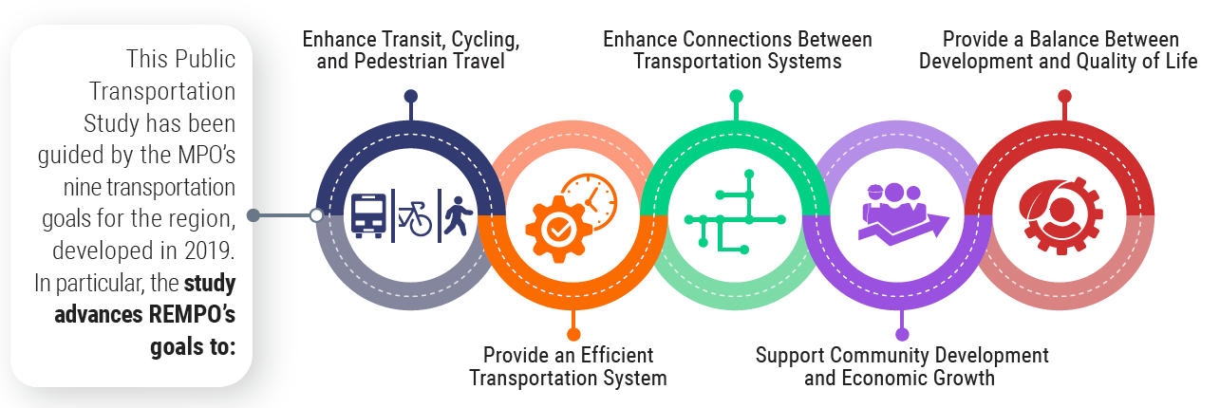
Goals
Purpose of Study
Enhance Transit, Cycling, and Pedestrian Travel:
Evaluate feasibility of a regional public transportation network, recommend next steps to construct a public transportation network.
Provide an Efficient Transportation System:
Reduce traffic congestion by providing alternatives to car travel, introduce publicly funded transportation options.
Enhance Connections Between Transportation Systems:
Introduce a bus mode to increase the range of bicycle and pedestrian travel, evaluate park-and-ride options.
Support Community Development & Economic Growth:
Enhance public transportation options for commuters, shoppers, and tourists.
Provide a Balance Between Development and Quality of Life:
Improve air quality through reduced vehicle emissions, provide accessible transportation options for more residents.

Slide 4
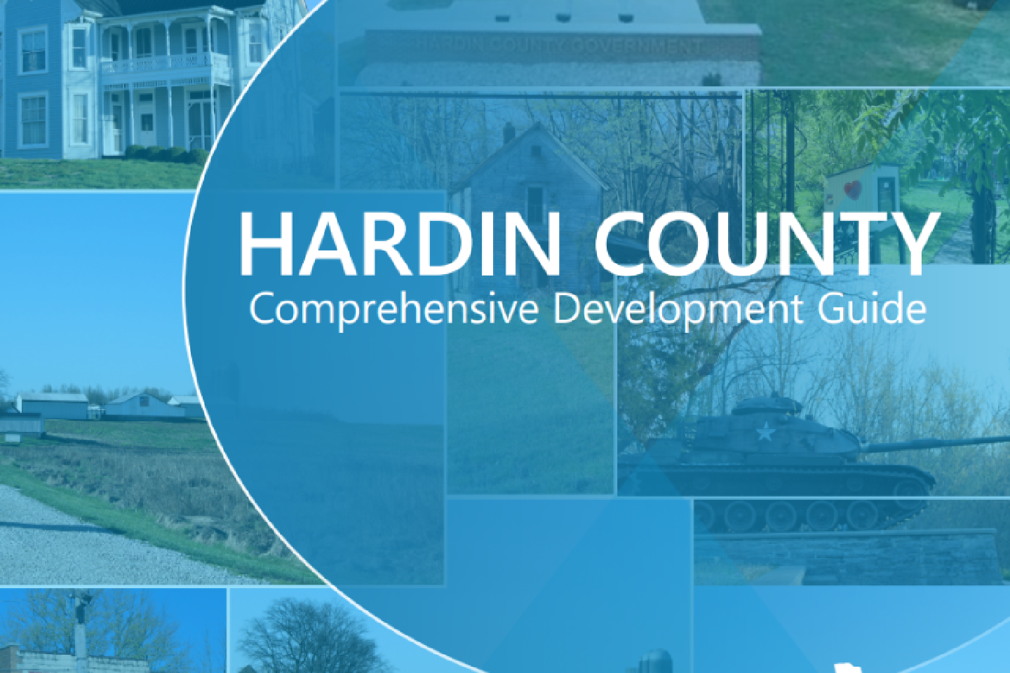
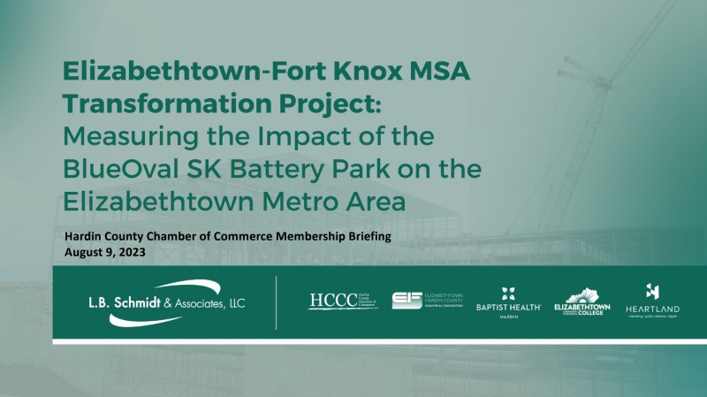
Previous Studies
Related Studies
Hardin County Comprehensive Development Guide - "This document provides all of the goals and objectives for the county over the next 20 years including the future land use plan and recommendations and action steps for the Planning Commission. The comprehensive plan update process started in July 2022 and was completed in July 2023. This process used the goals and objectives from the 2019 comprehensive plan as a starting point and focused on updating the plan to reflect the current conditions in Hardin County."
Elizabethtown-Ft. Knox MSA Transformation Project: Measuring the Impact of the BlueOval SK Battery Park on the Elizabethtown Metro Area, August 2023, Hardin County Chamber of Commerce - This is a summary of the briefing given to the members of the Hardin County Chamber of Commerce. The presentation was meant to inform those stakeholders of the anticipated impact the new facility would have on the surrounding community and among various demographics. Discussion topics included facility size, projected number of employees, construction obstacles and estimates, and potential economic impacts.

Slide 5
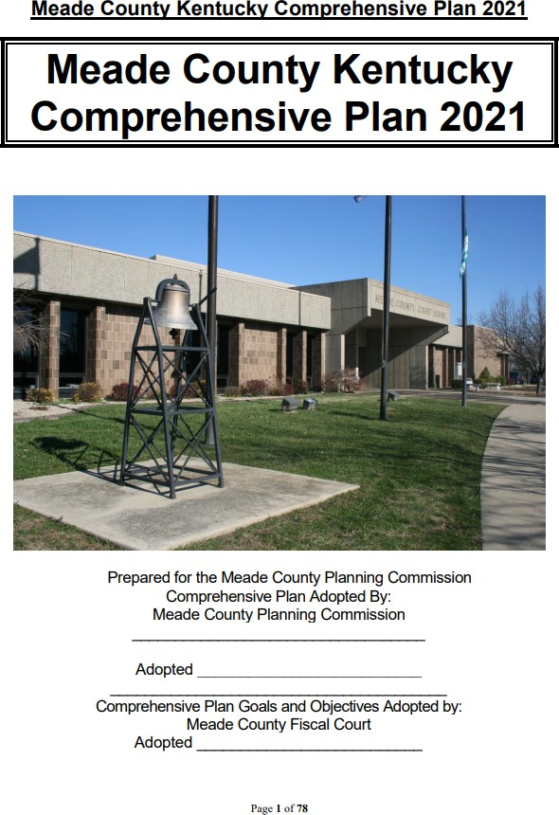
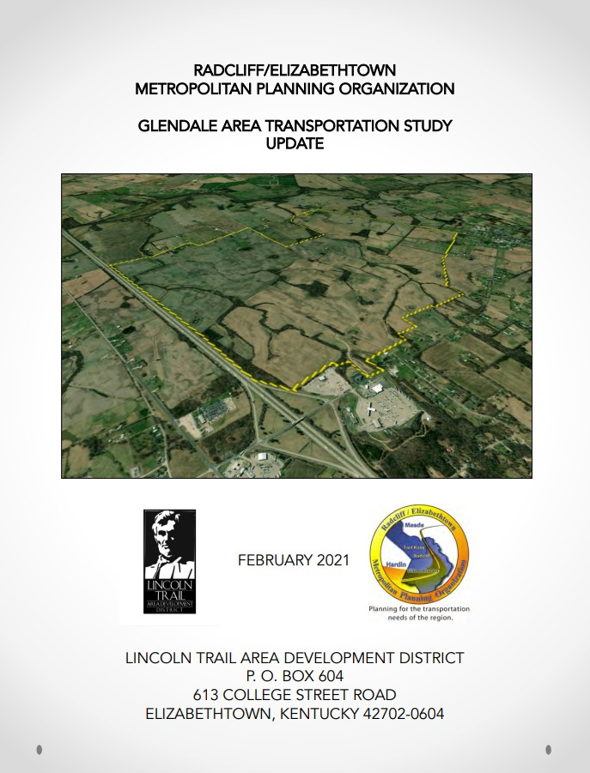
Related Studies
Meade County Kentucky Comprehensive Plan, 2021, Meade County Planning Commission - The primary purpose of the Comprehensive Plan was to account for the changes occurring in Meade County at the time as well as the expected changes over the next twenty years. The plan achieved this goal by evaluating existing community characteristics, engaging in extensive public participation, forming a communal vision, and administering an implementation plan for enacting the vision. Specific goals of the comprehensive plan included providing adequate infrastructure, enhancing community/public works related projects, encouraging education, and promoting lifelong learning. The implementation plan strived to achieve these goals by identifying and seeking potential funding sources for infrastructure improvement, pursuing financing for county-wide trail and park plans, diversifying educational opportunities, and promoting local business innovation.
Glendale Area Transportation Study Update, February 2021, REMPO - This study is an update to the previous 2008 Glendale Area Transportation Study and maintains the initial purpose of integrating the 1,551-acre parcel of land zoned for Heavy Industrial District use into the surrounding rural area with certain revisions. Short term revisions entail an entire I-65 interchange relocation and lane widening on KY 1136 along with the previous changes. Medium-range revisions were added including traffic control measures and an extension of the Glendale Bypass to connect with KY 222. Long-term plans now involve reconstruction of the CSX railroad crossing, along with complete bypass revisions on high traffic roadways and major roadway widening on high-traffic corridors. Overall, periodic revisions such as this study update are necessary in dynamic projects involving many alternative changes, various stakeholders, and large amounts of capital.

Slide 6
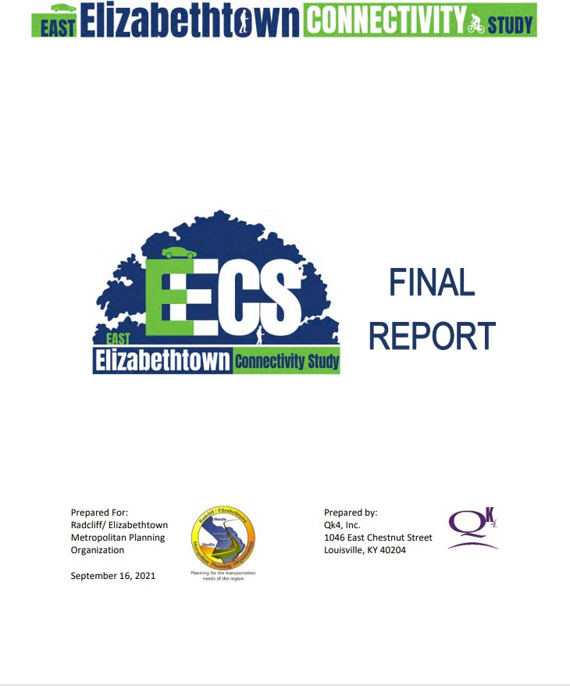
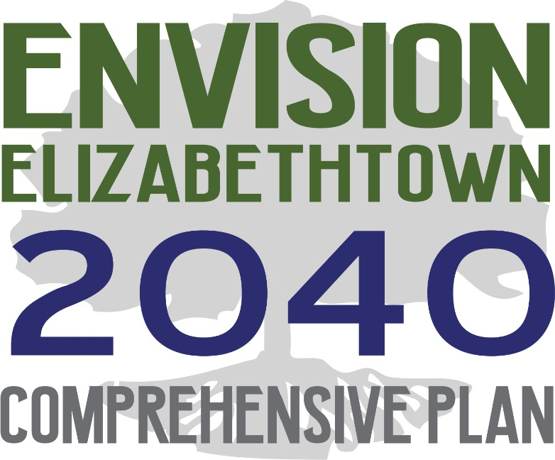
Related Studies
East Elizabethtown Connectivity Study Final Report, September 2021, REMPO & Kentucky Transportation Cabinet (KYTC) - The cooperative Connectivity Study sought to identify existing safety and congestion issues in transportation and pedestrian networks; the plan recognized and prioritized multiple recommended short-term and long-term projects. The methodology for developing these recommendations was to research existing planned projects in the area, review historic traffic and crash data, seek public and stakeholder input, complete an environmental, socioeconomic, and historical study, complete traffic forecasting, and run capacity analyses. Recommended areas for transportation and pedestrian network improvement included the US 62 Corridor, an undeveloped area along US 62 and Ring Road, and east of Interstate 65. Modifying these areas could improve transportation and pedestrian networks by extending existing roadways to form connections, lengthening existing trails and expanding recreational facilities, updating intersection alignment, adding pedestrian walkways, and various other measures. Ultimately, none of these improvements are discussed as separate from outside events or influences, instead all in cohesion with one another; this was a promising development as complete connectivity planning must pay equal attention to local and big-picture solutions.
Envision Elizabethtown 2040 Comprehensive Plan, October 2020, Elizabethtown Planning Commission, City Council, City Staff - The 2040 Elizabethtown Comprehensive Plan was used to determine policies, programs, and projects regarding future development along with goals and objectives to strengthen transportation and utility infrastructure, economic development, tourism, quality of life, and other aspects of life within Elizabethtown. The plan also delved into Elizabethtown’s contemporary demographic and economic development, transportation, community facilities, utilities, infrastructure, parks and recreation, and more. Goals pertaining to daily life in Elizabethtown such as Land Use & Redevelopment, Community Facilities, Transportation, and more are conveniently categorized into action steps with priority classifications such as high, moderate, and ongoing. This foresight is particularly useful for such a long- term, multifaceted plan. Extensive stakeholder engagement via meetings and interviews were thoroughly outlined and completed the comprehensive scope of the plan.

Slide 7
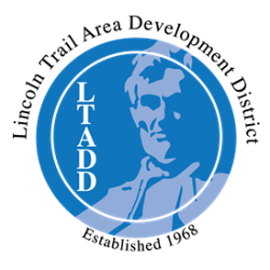
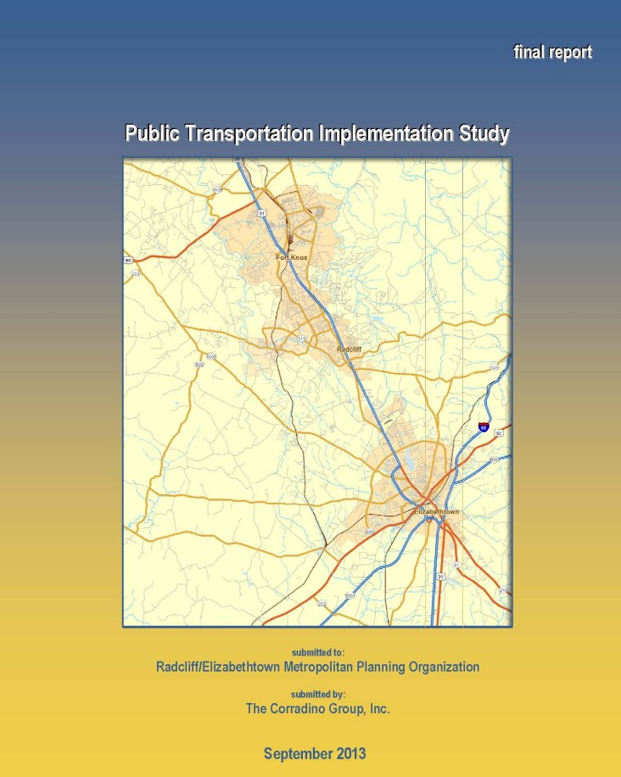
Related Studies
Title VI Implementation Plan, November 2018 – October 2019, LTADD - The Title VI Implementation Plan outlined how the non-discrimination statute called Title VI from the Civil Rights Act of 1964 is implemented across all LTADD’s programs ranging from housing to public service and economic development. Procedures for filing a discrimination complaint are detailed, along with a timeline for complaint submission. Further implementation details described the training of LTADD employees on Title VI procedures and specified who can respond to Title VI complaints. One of the most pertinent applications of Title VI related to data collection and how existing and future projects must adhere to Title VI data collection guidelines. Limited English Proficiency Title VI reporting procedures are also included in the plan, creating a more inclusive option for filing complaints or suggestions. The environmental justice component of the plan is also a welcome addition that bridges the conscious approach between the human and natural spheres.
Public Transportation Implementation Study, September 2013, REMPO - The study was intended to develop a plan for a fixed-route public transportation system that would connect Elizabethtown, Radcliff, and Fort Knox. The system would also include routes that circulated within each city and refined the routes for the transit system, determined locations for stops along routes, established the cost of shelters, estimated the capital and operating costs for the system, and proposed the financial match required for local government. To formulate such comprehensive solutions, the study extensively examined demographics and population statistics. An advantageous inclusion in the study was a transit generator section which outlined the primary need for transit trips such as reaching locations of educational institutions, medical appointments, housing, public offices, and recreation/shopping. The existing transit modes such as demand response, vanpool, park-and-ride, and their unique funding needs are also examined. The document also gauged public opinion regarding the transit system, new funding sources, routes, service hours, and proposed stops.

Slide 8
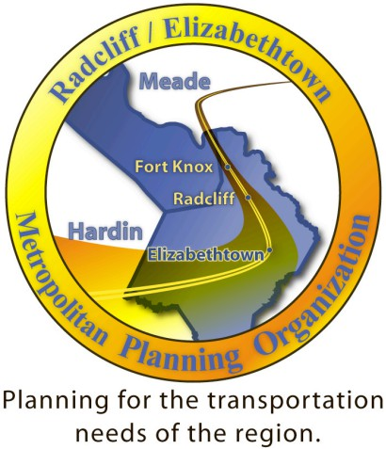
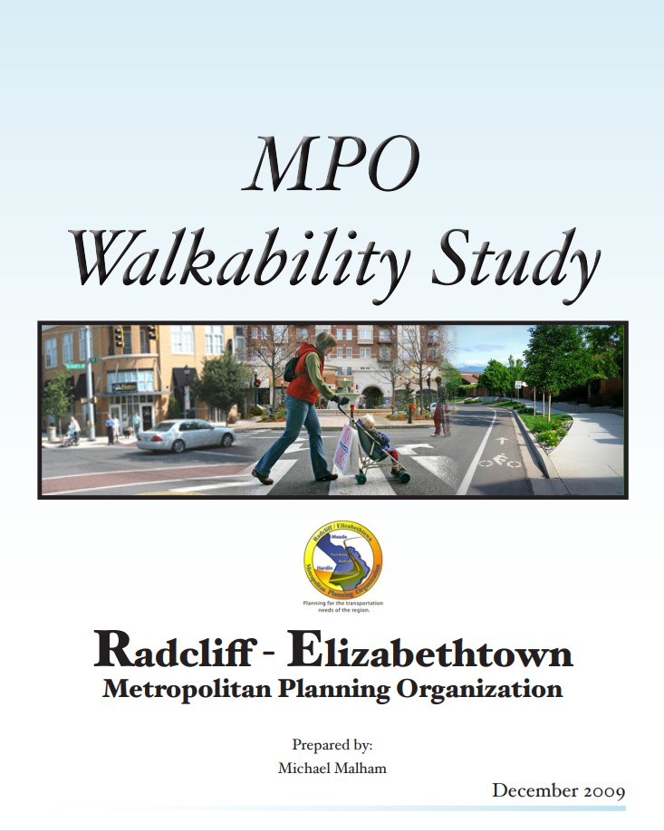
Related Studies
Bicycle Facilities Study Survey, 2012, REMPO - The bicycle facilities study survey was comprised of fifteen questions for cyclists and non-cyclists within the study area. The purpose of this study worked well in sequence with the 2009 Walkability Study as they both prioritized alternative modes of transportation instead of the single occupancy vehicle. The questions raised regard cycling frequency, nature of trips, cyclist comfort, cycling location, and many more. Along with these tangible questions, the survey inquired about the qualitative aspects of cycling in the county such as deterrent factors of cyclist comfort, positive factors that encourage cycling, and prospective areas for new cycling corridors. The survey was a useful tool for gauging the opinion of a subgroup which is sometimes neglected by planners.
MPO Walkability Study, December 2009, REMPO - The walkability study was delved into the existing walkability, a measure of pedestrian suitability and safety, in both Elizabethtown and Radcliff. The study was straightforward and immediately examined some of the urban planning issues hindering walkability in the study area. These issues included a decentralized urban core, sustainability, and a lack of viable, sustainable transportation options. The study even delved into the context of suburbanization and historical factors which caused the sprawling predicament that REMPO must contend with contemporarily. The document detailed metrics for measuring walkability such as land use variation, safety, path quality, and path context. Ultimately the findings were that the Radcliff area received an average walkability grade of “C”, with various neighborhoods receiving higher or lower ratings. This grade left plenty of room for improvement within the recommendations section as the study suggested remedies such as Complete Streets Policy integration, guidelines for pedestrian crossing, neighborhood connectivity, and education programs for bike/ped awareness.

Slide 9
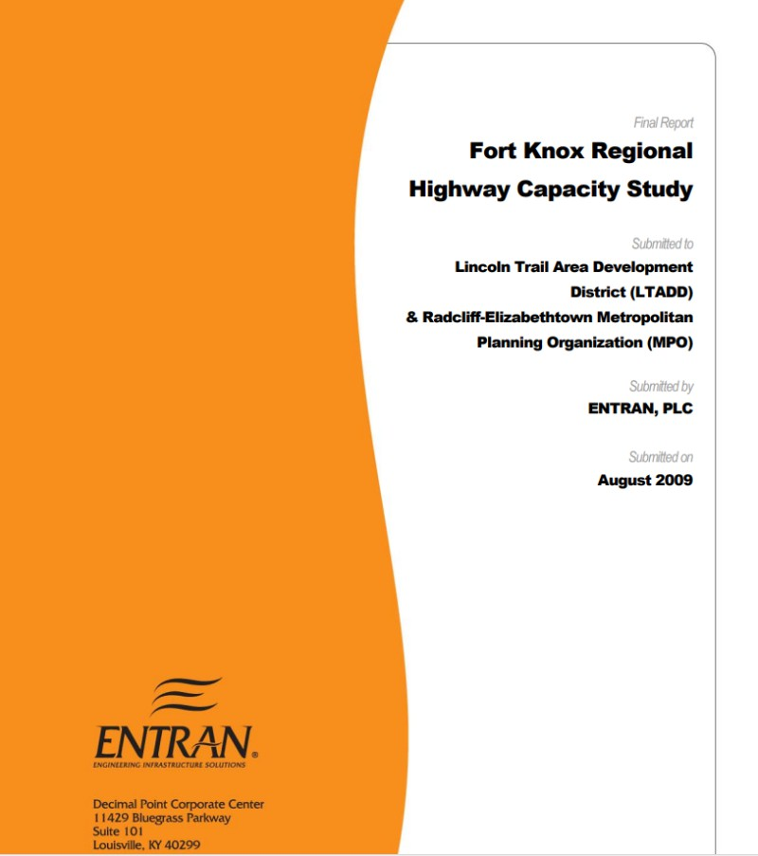
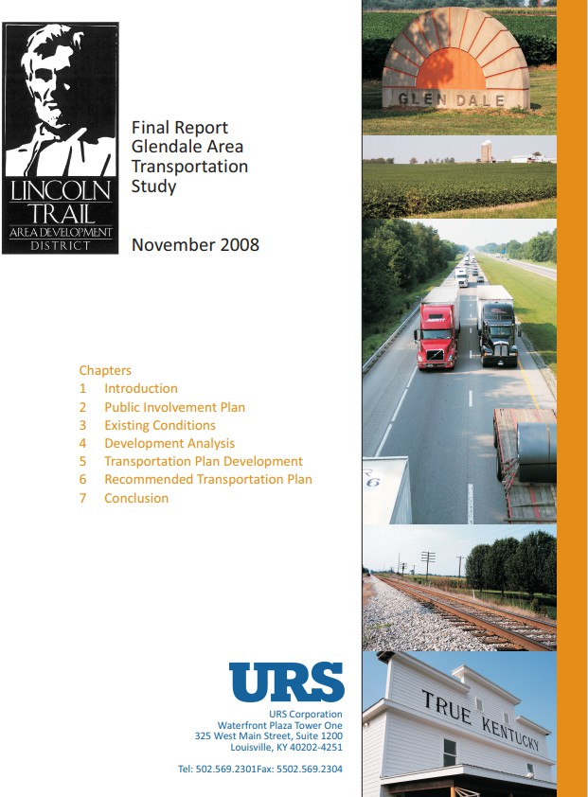
Related Studies
Fort Knox Regional Highway Capacity Study, August 2009, Radcliff/Elizabethtown Metropolitan Planning Organization (MPO) and the Lincoln Trail Area Development District (LTADD) - The study identified potential improvements to aid in traffic flow and provide better connections to major roadways on a regional level within the Fort Knox area. The study area included the counties of Breckinridge, Bullitt, Grayson, Hardin, Larue, Marion, Meade, Nelson, and Washington, but was primarily focused on Hardin, Meade, and Bullitt counties. Existing conditions, future conditions, community outreach, and recommendations were all thoroughly examined throughout the study. The recommendations section included solutions such as extensions existing corridors to accommodate for capacity growth, connector roads between high-capacity roadways, interchange redesigns, and combined/eliminated median openings. These solutions improved roadway efficiency and safety along with accounting for diverse modes of transportation by integrating a regional public transportation study. Further accommodations were made in collaboration with Smart Growth Patterns and input from members of the neighboring city, Radcliff.
Glendale Area Transportation Study, November 2008, Lincoln Trail Area Development District - The study proposed short, medium, and long-range projects to integrate a 1,551-acre parcel of land zoned for Heavy Industrial District use into the surrounding rural area without compromising area mobility. These plans were to be incrementally implemented to distribute costs, making the plan both fiscally responsible and scalable to grow as the development expands. The study contained a public involvement plan, existing conditions report, development analysis, and a recommended transportation plan. The recommended transportation plan outlined short- range improvements such as adding left-turn lanes at downtown Glendale intersections, improving bypasses on KY 222 and amending bypasses on KY 1136. Medium range improvements were specified as more intensive procedures such as roadway widening, roadway replacement, and signal revision. Long range improvements were the most labor and funding intense such as complete bypass revisions on high traffic roadways and major roadway widening on high-traffic corridors such as I-65. Overall, these highway and local roadway improvements streamlined the accommodation

Slide 10
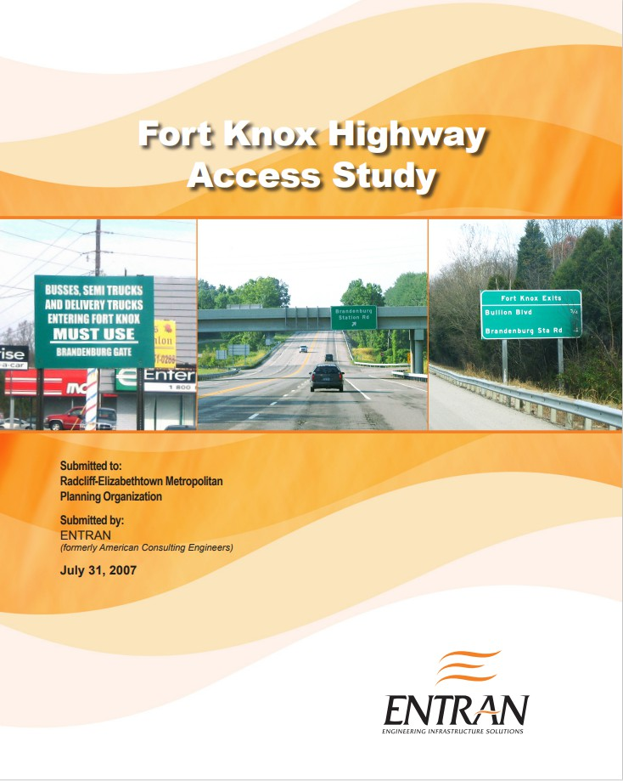
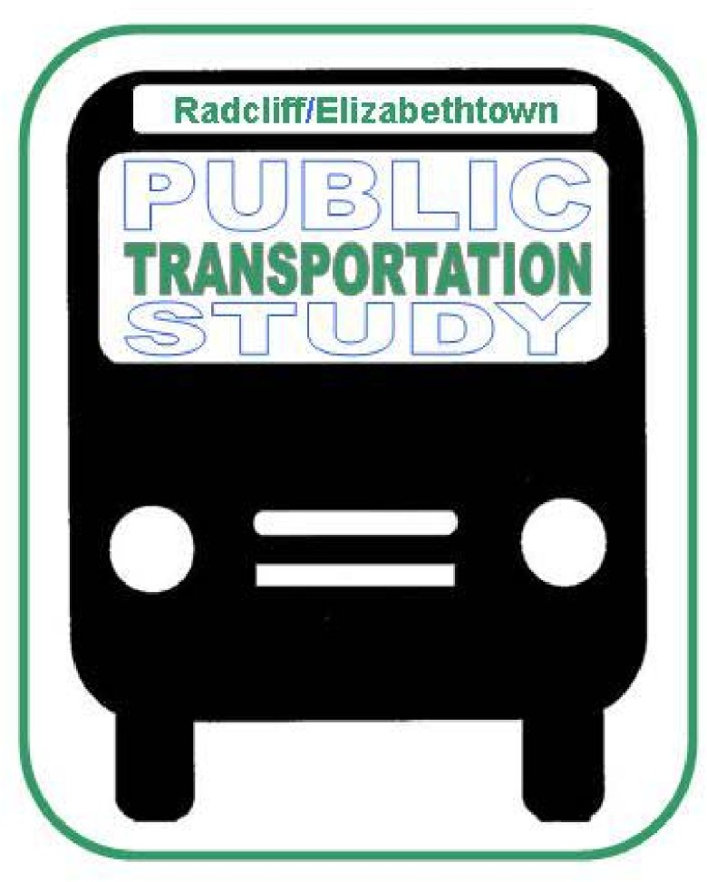
of a large manufacturing center, final point of assembly, or other facility via proposed steps for requisite roadway improvement.
Related Studies
Fort Knox Highway Access Study, July 2007, REMPO - The study was conducted to proactively identify and address anticipated traffic problems relating to the U.S. Department of Defense 2005 Base Realignment and Closure (BRAC) Report. This report detailed many changes that occurred on the Fort Knox Military Reservation that affected the surrounding region. The study accommodated these base relocation specific changes, along with attending to the general population and traffic growth experienced by the Radcliff-Fort Knox area in recent years. Proposed solutions for improving access to Fort Knox from the adjoining highway system such as US 31W included improving the adjacent North Wilson Road via widening the existing lanes, eliminating a slip ramp, and adding a turning lane. Other traffic reducing measures included reconstructing Brandenburg Station Road and the adjacent US 31 to accommodate new entrance and exit ramps along with lane widening. Diverse solutions such as an employee shuttle from Elizabethtown and Louisville to Fort Knox were also proposed as
Radcliff/Elizabethtown Public Transportation Study Final Report, September 2005, REMPO - The REMPO Public Transportation Study Final Report required a holistic outline of the Radcliff-Elizabethtown area. The 2000 Census designated that a Metropolitan Planning Organization (MPO) was required to oversee the communities in the area. This means that the MPO needed to outline how the existing demographic and socioeconomic conditions/needs of the area and their organizational transportation services/goals within the region interacted. Community involvement was also essential as stakeholder engagement provided important feedback relating to desired service area, service hours, and fare price. Once assessments of existing needs and future service desires were addressed, three phases of recommendation were proposed to fulfill fixed-route service expansion requests and the possible financial costs of these expansions.

Slide 11
Stakeholders
Baptist Health Hardin Hospital
BlueOval SK
City of Brandenburg
City of Elizabethtown
City of Radcliff
City of Vine Grove
Elizabethtown Community and Technical College
Family Scholar House
Elizabethtown/Hardin County Industrial Foundation
Fort Knox
Hardin County
Hardin County Chamber of Commerce
Meade County
Meade County Economic Development
Nucor Steel
Transit Authority of Central Kentucky (TACK)

Slide 12
Key Takeaways from Stakeholder Meetings
Some key themes recurred across multiple stakeholder interviews, and the project team learned several lessons from stakeholders that will inform any potential service developments:
Interest in Carpooling
Many commuters and students are open to carpooling or vanpooling, and some employers already have programs to facilitate carpools.
Carpooling and vanpooling can originate at either private residences or at regional park-and-ride locations.
Existing Transportation Options Leave Significant Gaps
Major destinations are decentralized across a wide area, making mileage-based fees prohibitive for many students, medical patients, and commuters.
A lack of transportation options is significantly impacting residents’ abilities to seek or complete the kind of education and training that would help fill much-needed jobs in industrial and healthcare positions. These transportation barriers are also impacting potential tax revenues.
Longer service hours are needed for students, medical patients, and employees working second and third shifts.
Broad Support for Expanding Public Transportation
With new industries and large employers moving into the region, the time is right to invest in public transportation.
TACK is willing to partner with REMPO and stakeholders to take the next steps for expanding and enhancing public transportation services to Hardin and Meade Counties.
Local government officials are open to providing assistance with signage, benches, talking with business owners, coordinating with KYTC about park-and-ride facilities, and potentially addressing funding needs.

Slide 13
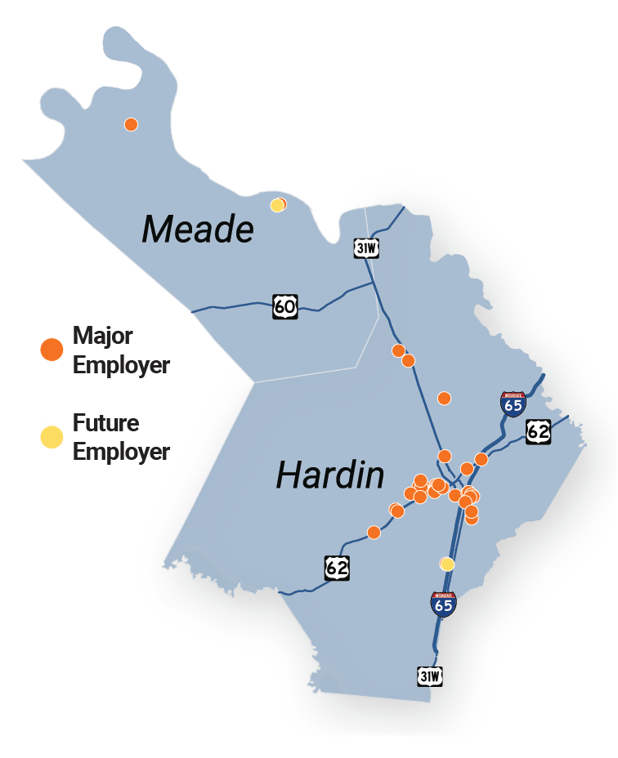
Major Employers

Slide 14
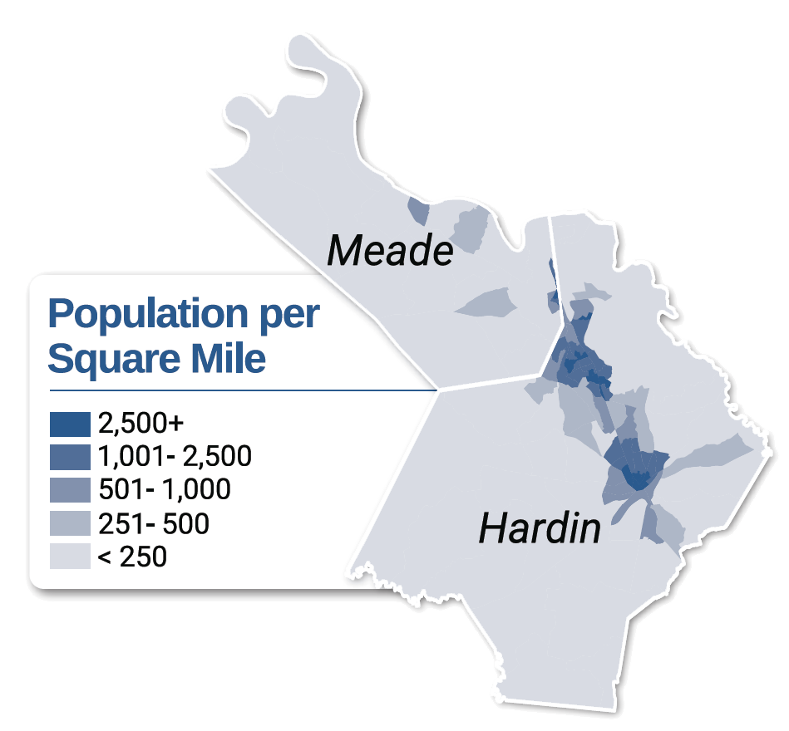
Population & Demographics
The region covered by the Radcliff/Elizabethtown Metropolitan Planning Organization consists of two counties and a federal military installation: Hardin County, Meade County, and the Fort Knox Army Installation which spreads across Hardin, Meade, and Bullitt Counties, however, all the base housing and facilities lie within Meade County. The study area also includes nine incorporated cities, ranging in size from Elizabethtown (pop. 31,066) to Ekron (pop. 262). Both residents and employers in the region are centered around the City of Elizabethtown, the City of Radcliff, and Fort Knox Army Post, with other major employers located in the City of Brandenburg and the City of Glendale.

Slide 15
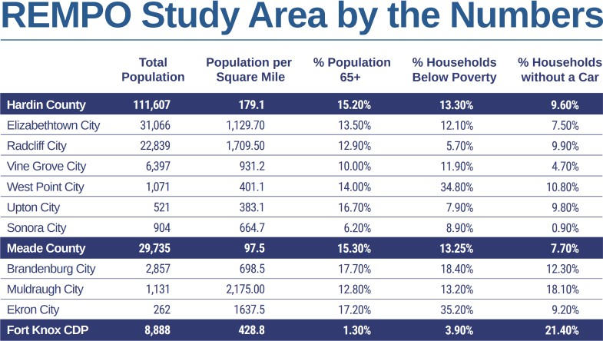
Population & Demographics
The population demographic breakdown for the REMPO area is shown in the table.

Slide 16

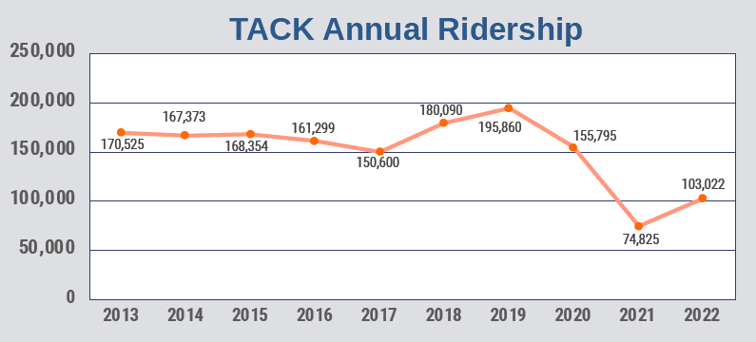
Existing Public Transportation
The Transit Authority of Central Kentucky (TACK) is the primary provider of public transportation services to Hardin and Meade Counties. Founded in 2012 to address the lack of public transportation in the Elizabethtown-Fort Knox region, TACK provides on-demand, shared ride services only. Despite being classified as a large urban transit agency, it does not operate any fixed-route service. Residents of Meade and Hardin Counties can book door-to-door trips to anywhere within and outside the region, including non- emergency transportation for Medicaid recipients who do not have transportation that can fit their needs.
As seen in the graph, ridership on all TACK services peaked in 2019 at 195,860 annual trips. Ridership declined significantly from 2019-2021 during the COVID-19 pandemic, reaching a low of 74,825 trips in 2021. Ridership has since seen a 52.6% recovery in 2022, with 103,022 trips.

Slide 17
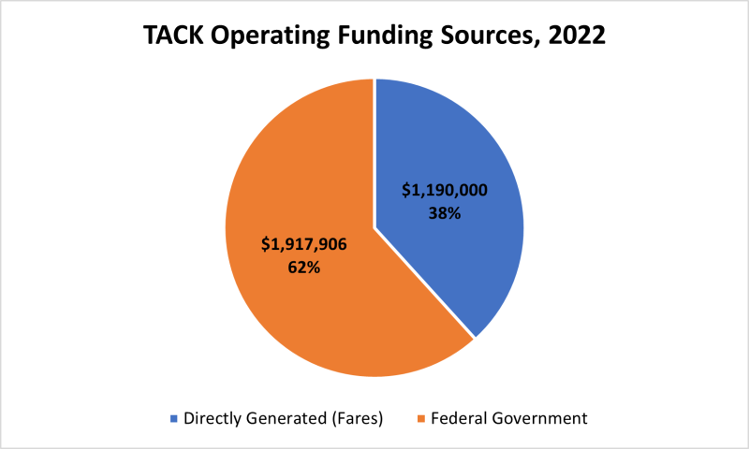

Existing Public Transportation
In 2022, TACK met 38% of its operating budget through directly generated funding, such as collecting fares and advertising. The remaining 62% was funded by Federal Government subsidies; the agency receives no funding from state or local sources.
Although there are currently no public transportation services that operate within the Fort Knox Military installation, all Army employees can take advantage of the Mass Transportation Benefits Program (MTBP) to offset up to $315 of transit costs per month. At Fort Knox, this allows Army personnel to use vanpool services offered by Every Commute Counts (ECC), a program for the greater Louisville Metro Area administered by the Kentuckiana Regional Planning and Development Agency (KIPDA). There are currently 11 daily ECC vanpools that stop at different locations inside the base.

Slide 18
Survey Results
Issues & Concerns
Do you currently own or have access to a personal vehicle?
Yes: 82.40%
No: 17.60%
How many days per week do you currently travel?
0-1: 4.42%
2-3: 11.03%
4-5: 27.53%
6-7: 57.02%
What time do you usually arrive at work/school?
7 AM – 8 AM: 42.46%
8 AM – 9 AM: 20.18%
9 AM – 10 AM: 8.73%
Other: 28.63%
What time do you usually leave work/school?
3 PM – 4 PM: 22.32%
4 PM – 5 PM: 27.75%
5 PM – 6 PM: 22.39%
Other: 27.54%Y
The Radcliff/Elizabethtown Metropolitan Planning Organization conducted a public survey to collect supporting information for the Public Transportation Study that would help determine what the public transportation need was for Hardin and Meade Counties.
The survey was open from March 1, 2024 to April 5, 2024 and was advertised on social media and through local channels and received over 1,400 responses. The following is a summary of the results.

Slide 19
Survey Results
How do you usually get around? (Check all that apply.)
Walking: 14.73%
Bicycling: 3.16%
Personal Vehicle: 54.95%
Carpool/Ride with Friend or Relative: 16.55%
Demand/Response Service (TACK): 3.63%
Vanpool: 1.24%
Taxi, Uber, Lyft, etc.: 5.64%
Every Commuter Counts Service (MBTA): 0.10%
Do you use any of the following public transportation services?
Demand/Response Service (TACK): 9.77%
Taxi, Uber, Lyft, etc.: 20.60%
Every Commuter Counts Service (MBTA): 0.13%
Vanpool: 2.47%
I do not use any public transportation services: 67.02%
Questions such as current mode of travel, current use of public transportation services, and frequency of use were asked.
How many days per week do you currently use public transportation?
0-1: 87.66%
2-3: 4.75%
4-5: 3.69%
6-7: 3.90%

Slide 20
Survey Results
What do you consider the top benefits of using public transportation services? (Check all that apply.)
Reliable alternative if other transportation is unavailable: 37.17%
Wheelchair accessible / paratransit needs: 13.60%
Spending time working/resting/ reading/socializing rather than driving: 11.16%
Cheaper than owning a car or paying for ride-hailing service: 19.26%
Reduces vehicle emissions and improves air quality: 18.82%
What type of trips would you consider making if public transportation were more readily available? (Check all that apply.)
Commuting to work: 22.70%
Commuting to school: 7.72%
Medical Appointments: 2.31%
Recreational / Social Trips Shopping or personal errands: 26.76%
Workday business meetings or professional gathering: 10.60%
Concerning benefits of public transportation, respondents stated that a reliable alternative mode of transportation was most important to them, for their trips to work, shopping, school, etc.

Slide 21
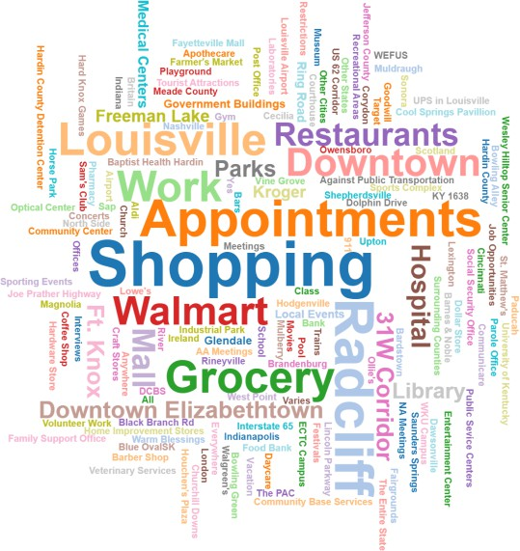
I would not consider using public transportation services: 9.91%
Are there specific destinations or areas that you would travel to if they were accessible by public transportation?
Survey Results
Which of the following are personal obstacles for you to use public transportation services, including demand-response services? (Check all that apply.)
Not aware of public transportation services offered in the area: 29.53%
Do not understand how to use public transportation services: 5.89%
Too expensive: 9.06%
Need for a car during the workday for work or personal errands: 13.77%
Lack of sidewalks or safe streets: 15.50%
Service takes too long: 10.16%
Service isn’t available at the times of day when I need it: 16.09%
Does not accommodate wheelchairs or young travelers using car seats: 7.64%
Uncomfortable with unknown/untrained drivers: 18.75%
Unfamiliar with the program: 8.26%

Slide 22
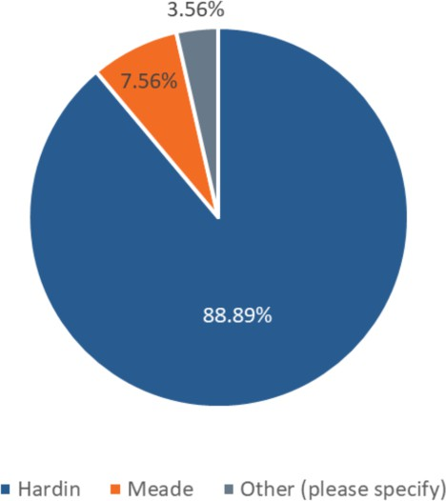
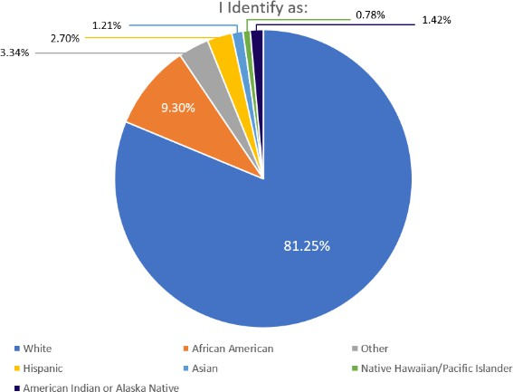
Survey Demographics
In what county do you live?
I identify as: (Check all that apply)
African American: 131
White: 1144
Hispanic: 38
Asian: 17
Native Hawaiian/Pacific Islander: 11
American Indian or Alaska Native: 20
Other: 47
Hardin: 1200
Meade: 102
Other: 48

Slide 23
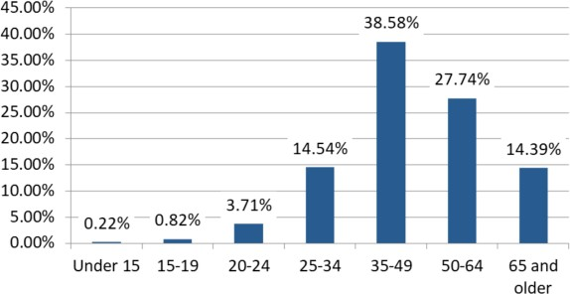
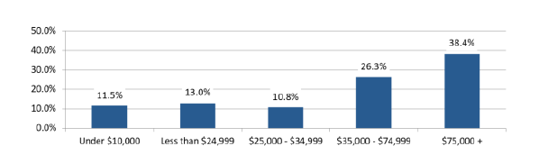
Survey Demographics
My age is:
What is your household income?
Under age 15: 3
Aged 15-19: 11
Aged 20-24: 50
Aged 25-34: 196
Aged: 35-49: 520
Aged 50-64: 374
Aged 65 and older: 194
Under $10,000: 152
Less than $24,999: 171
$25,000 - $34,999: 142
$35,000 - $74,999: 347
$75,000+: 506

Slide 24
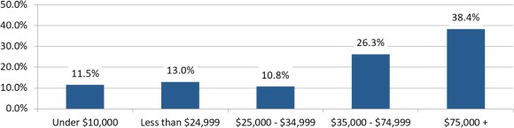
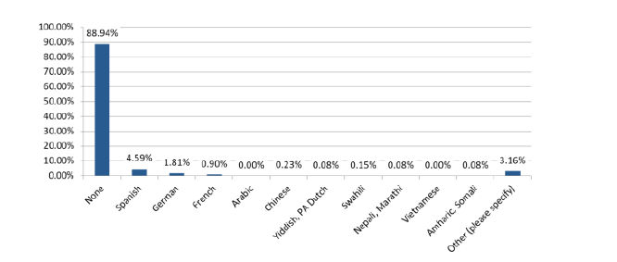
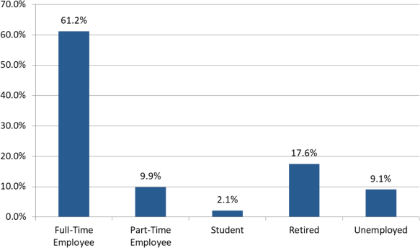
Survey Demographics
Which of the following best describes your employment status? (Check all that apply.)
What other languages are spoken within your household?
None: 1,182
Spanish: 61
German: 24
French: 12
Chinese: 3
Yiddish/PA Dutch: 1
Swahili: 2
Nepali/Marathi: 1
Amharic/Somali: 1
Other: 42 (no other languages reported)
Full-Time Employee: 826
Part-Time Employee: 134
Student: 29
Retired: 237
Unemployed: 123

Slide 25
Recommended Strategies
Drawing on lessons learned from previous studies, stakeholder interviews, demand analysis, a peer review, and transportation best practices, there are several strategies that REMPO, TACK, and other local partners could take to improve public transportation in the Radcliff/Elizabethtown area. This approach has been broken down into three main phases, to take advantage of existing equipment and to allow for funding support to be built over time.
Phase 1 (2025) - Coordinate Vanpools
Coordinate with industries such as Baptist Health, ECTC, BlueOval SK, and Fort Knox to organize vanpools with TACK's existing vanpool fleet
Advertise commuter options to employees
Consider replicating the Every Commute Counts program to create incentives for employees and students to use the vanpool

Slide 26
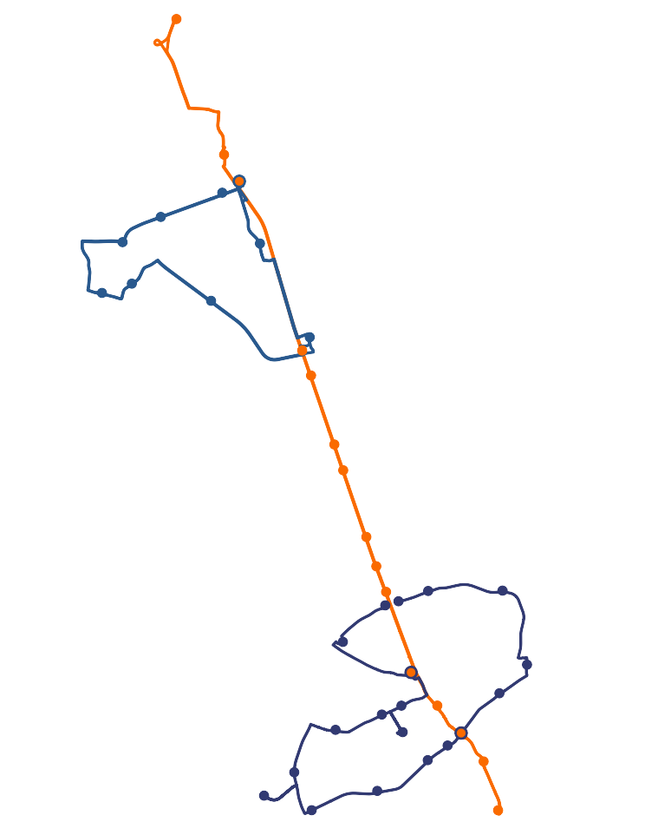
Phase 2 (2026-2028) - Implement Fixed-Route Services
Purchase between six and nine 14-seater cutaway buses (5339 grant)
Coordinate with stakeholder to identify annual operating funds
Implement fare-free bus routes with new cutaway buses (Elizabethtown Circulator, Radcliff/Vine Grove Circulator, Fort Knox/Elizabethtown Connector)
Extend TACK's paratransit service coverage to include evening and weekend hours for the 3/4-mile areas around fixed routes
Install signs at all new bus stops
Install bus shelters and benches at key bus stops
Fort Knox Visitors Center
¯
0 0.5 1
2 Miles
£¤31W
Radcliff
Radcliff City Hall
Walmart Ollie's / Park & Ride
Vineland Carriage Homes ¹⁸¹⁵
Brandy Chase Apartments
Vine Grove
1500
Vine Grove City Hall
Baptist Health
313
313
Urgent Care
Gateway Crossings
Lincoln Trail Behavioral Health
220
Rural King
£¤31W
1600
Dixie Highway Shopping Plaza
Cool Springs Shopping Center
¦¨§
Towne Mall / Walmart
£¤62
Kroger / Dolphin Dr.
65
Hardin County Gov't Center
3005
Elizabethtown
Baptist Health
Hardin County
Library
Hardin
KY Career Center
Industrial
Park
ECTC
Elizabethtown City Hall
£¤62
Dollar General
Warm Blessings
Elizabethtown Park & Ride

Slide 27
Phase 3 (2030+) - Expand Service
Purchase or build new vehicle storage and maintenance facility
Invest in pedestrian infrastructure, such as sidewalks and signalized crosswalks
As funding and demand allow, extend the Fort Knox Connector south to Glendale and North to West Point incorporating BlueOval SK and the Glendale industrial park
Consider adding a Brandenburg connector to connect locations in Brandenburg with Fort Knox or Radcliff

Slide 28
TACK can offset the annual operating costs of new fixed-route bus service by using previously untapped federal grants. These grants supply 80% of the necessary funds for capital expenses (new vehicles, bus stops, etc.) and 50% of the operating expenses (driver wages, vehicle maintenance, property leases, etc.). This leaves only 20%-50% of the total costs to be supplied from local sources or other federal programs like Medicaid.
Available Funding Sources
Federal Grant for New Vehicles (5339 Program)
Federal Grant for Operating Funds (5307 Program)
Funds from Local Governments
Funds from Medicaid Non-Emergency Medical Transportation (NEMT)
Revenue from Advertisements
Service Agreement with Major Employer
Financial Analysis

Slide 29
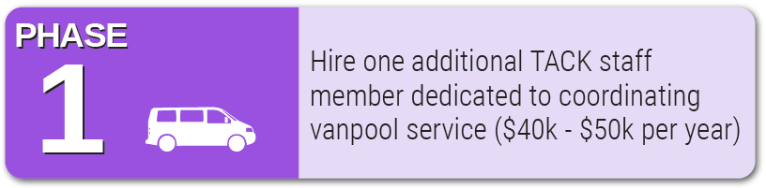
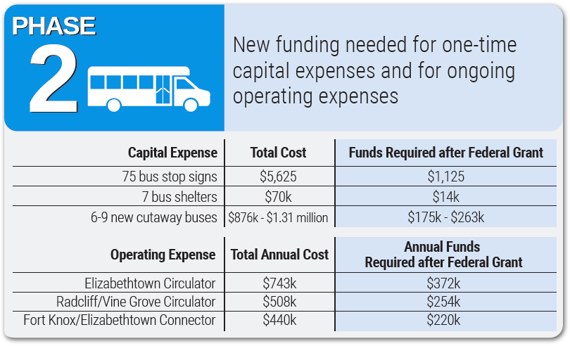
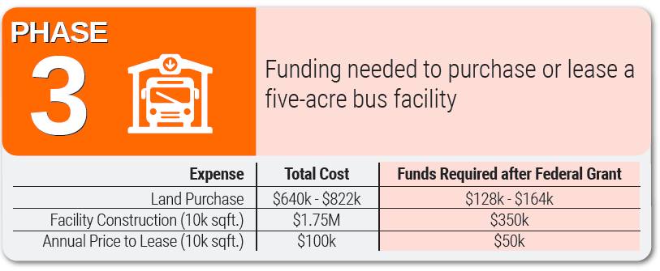
Funding Needs by Phase

Slide 30
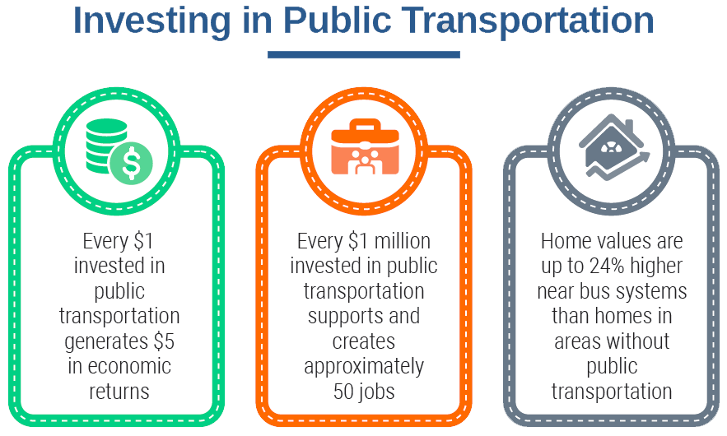
Next Steps
Successful implementation of fixed-route public transportation and enhancement of existing public transportation in Meade and Hardin Counties will require action from many stakeholders and supporters.
Step 1
Establish a vanpool coordinator
Apply for and earmark FY26 funds for operating and capital costs
Step 2
Perform public engagement
Purchase six to nine cutaway buses
Finalize details of new service
Step 3
Install bus stop signs and shelters
Advertise upcoming bus service
Implement new service

Slide 31
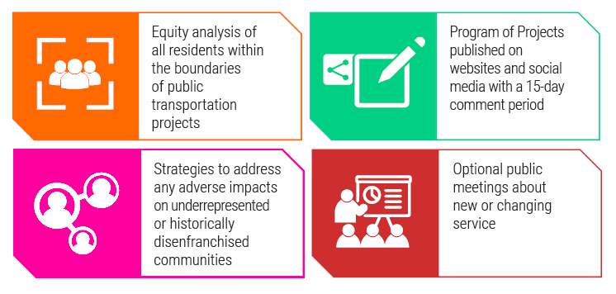

Public Engagement and Equity Requirements
Any new public transportation service that REMPO or TACK undertakes is subject to public engagement and equity requirements laid out in REMPO’s Public Participation Plan and the Lincoln Trail Area Development District’s (LTADD) Title VI Implementation Plan:
Equity analysis of all residents within the boundaries of public transportation projects
Strategies to address any adverse impacts on underrepresented or historically disenfranchised communities
Program of Projects published on websites and social media with a 15-day comment period
Optional public meetings about new or changing service

